Slide 1
Top Task
Management
Gerry McGovern
gerry@customercarewords.com
www.customercarewords.com

Slide 2
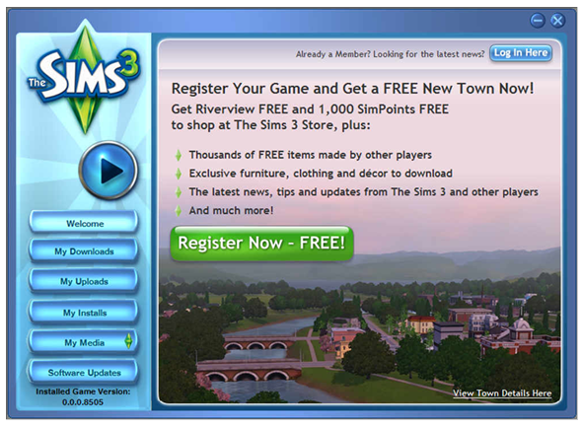
Notes:
Actual Test Results: Version A’s ‘Free Town’ offer paired with an image of the virtual town got 40.1% more consumers to fill out and submit a non-required registration form after they installed the game they’d purchased offline.
WiderFunnel Marketing Optimization, a conversion optimization firm, used Google Website Optimizer to conduct the A/B test on The Sims 3 game launcher page. All versions were designed to fit a screen at 600×800 resolution so that no buttons appeared below the fold. The test ran until it hit 99.9% conclusiveness.
Both pages had identical buttons and nav bars. The benefits for both offers were also identical, but the copy describing them differed. Version A’s headline emphasized the ‘Free Town’ offer whereas Version B’s headline emphasized the ‘Free Game Content’ offer. Images matched the narrative of the copy.
Gamers obviously valued the town over game content, like furniture and clothing. And with 12.2 million uniques per month, a 40.1% lift amounts to thousands of new registrants. Does your product or offering have multiple benefits? If so, do you know which is most appealing to prospects? It’s worth testing to find out.

Slide 3
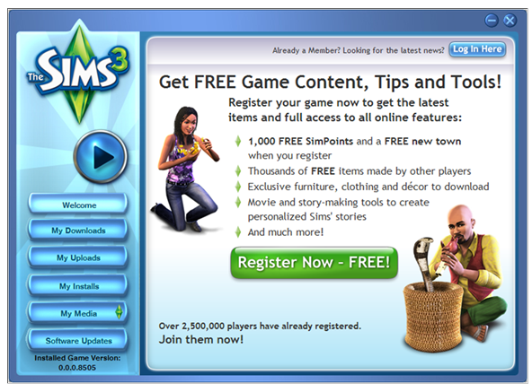
Notes:
Actual Test Results: Version A’s ‘Free Town’ offer paired with an image of the virtual town got 40.1% more consumers to fill out and submit a non-required registration form after they installed the game they’d purchased offline.
WiderFunnel Marketing Optimization, a conversion optimization firm, used Google Website Optimizer to conduct the A/B test on The Sims 3 game launcher page. All versions were designed to fit a screen at 600×800 resolution so that no buttons appeared below the fold. The test ran until it hit 99.9% conclusiveness.
Both pages had identical buttons and nav bars. The benefits for both offers were also identical, but the copy describing them differed. Version A’s headline emphasized the ‘Free Town’ offer whereas Version B’s headline emphasized the ‘Free Game Content’ offer. Images matched the narrative of the copy.
Gamers obviously valued the town over game content, like furniture and clothing. And with 12.2 million uniques per month, a 40.1% lift amounts to thousands of new registrants. Does your product or offering have multiple benefits? If so, do you know which is most appealing to prospects? It’s worth testing to find out.

Slide 4
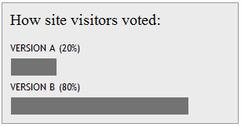
A
B
Notes:
Actual Test Results: Version A’s ‘Free Town’ offer paired with an image of the virtual town got 40.1% more consumers to fill out and submit a non-required registration form after they installed the game they’d purchased offline.
WiderFunnel Marketing Optimization, a conversion optimization firm, used Google Website Optimizer to conduct the A/B test on The Sims 3 game launcher page. All versions were designed to fit a screen at 600×800 resolution so that no buttons appeared below the fold. The test ran until it hit 99.9% conclusiveness.
Both pages had identical buttons and nav bars. The benefits for both offers were also identical, but the copy describing them differed. Version A’s headline emphasized the ‘Free Town’ offer whereas Version B’s headline emphasized the ‘Free Game Content’ offer. Images matched the narrative of the copy.
Gamers obviously valued the town over game content, like furniture and clothing. And with 12.2 million uniques per month, a 40.1% lift amounts to thousands of new registrants. Does your product or offering have multiple benefits? If so, do you know which is most appealing to prospects? It’s worth testing to find out.

Slide 5
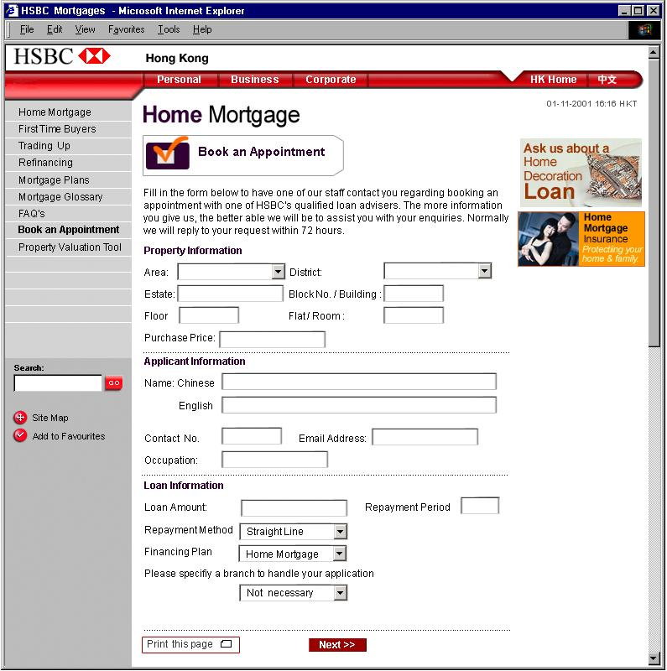
2 enquires a week

Slide 6
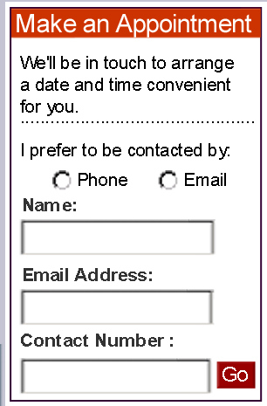
180

Slide 7
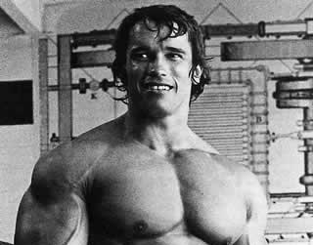
$20 M
$1 M
Notes:
First 4 months with new form: $20 million mortgages sold. Previous four months with old form: less than $1 million

Slide 8


Slide 9


Slide 10


Slide 11
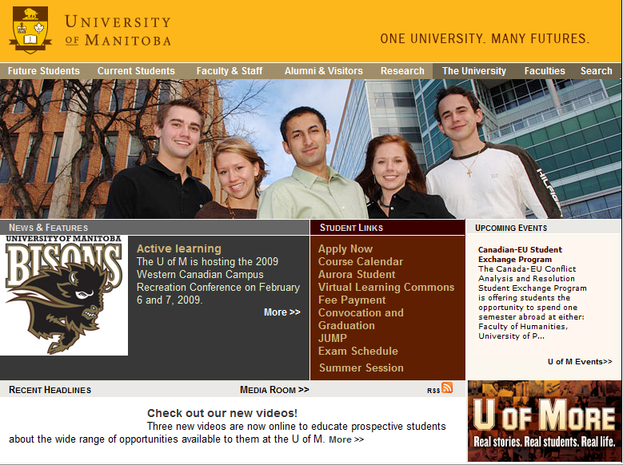

Slide 12
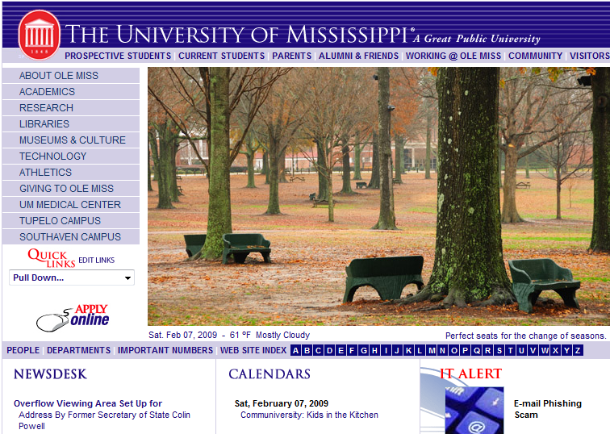

Slide 13


Slide 14
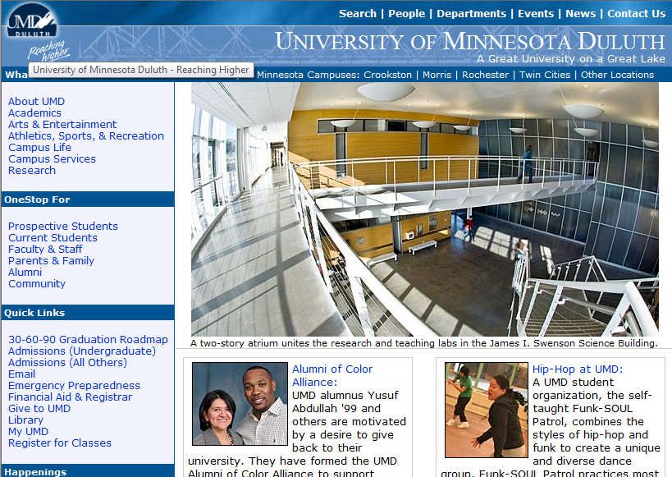

Slide 15


Slide 16
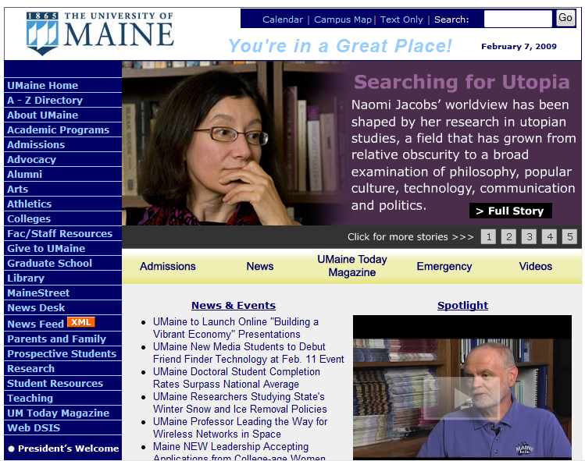

Slide 17


Slide 18
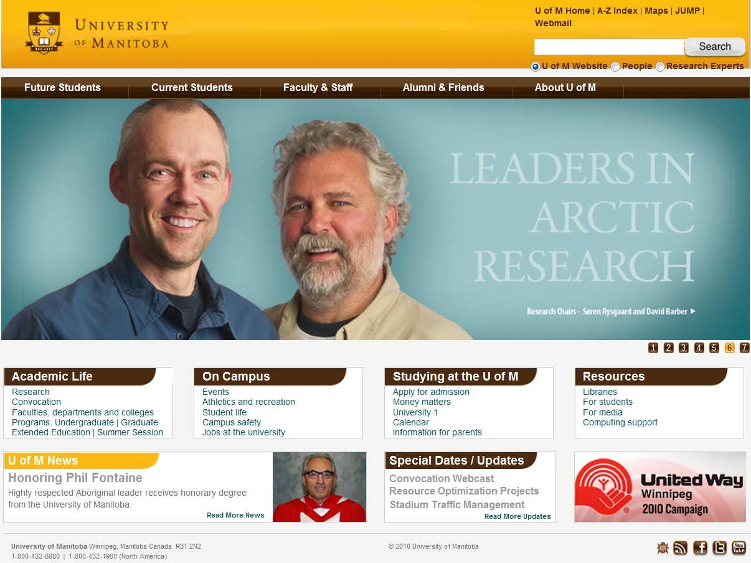

Slide 19
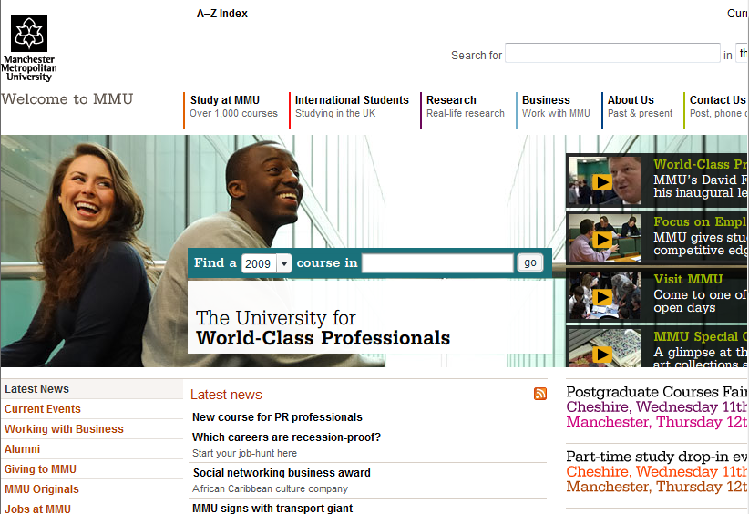

Slide 20


Slide 21
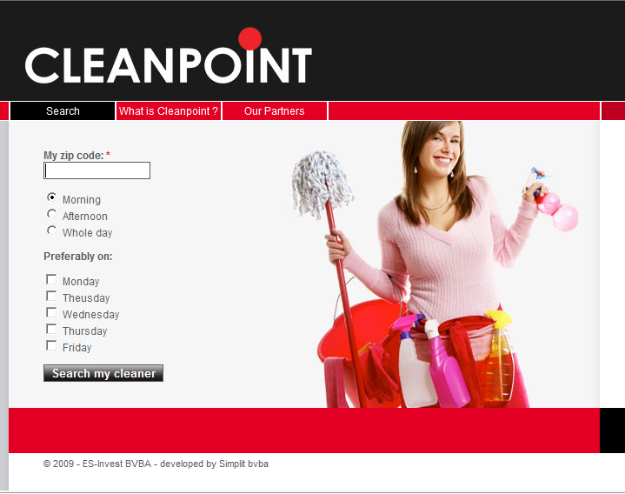

Slide 22
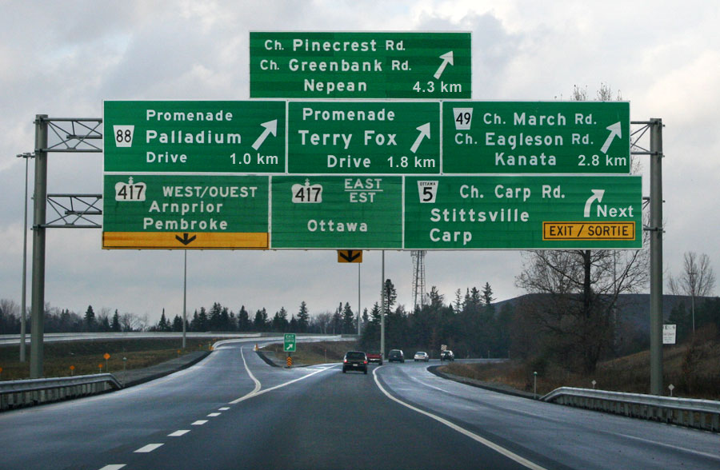
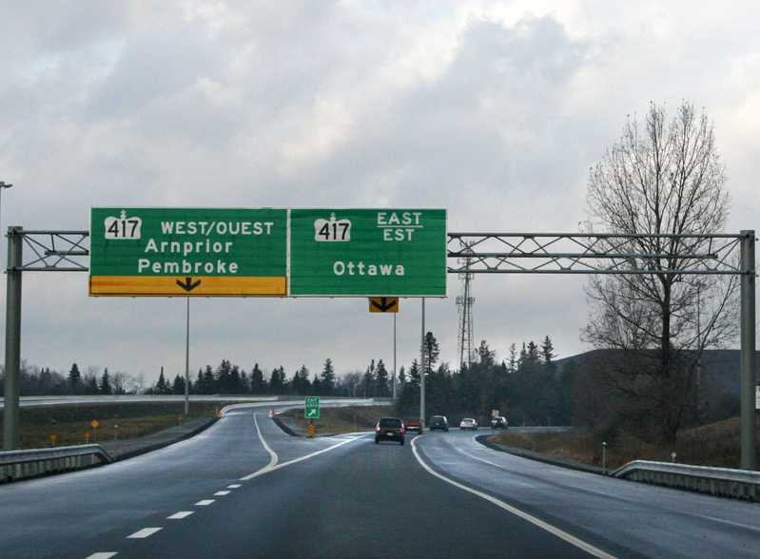

Slide 23
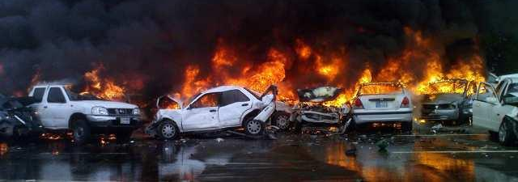
Places
Populated
Area
Large Metro
Area
Cities
Capital Cities
Of Canada

Slide 24
Useless
Links
Stuff
Tools
Content
Infinity &
Beyond
FAQS
Slow Links

Slide 25
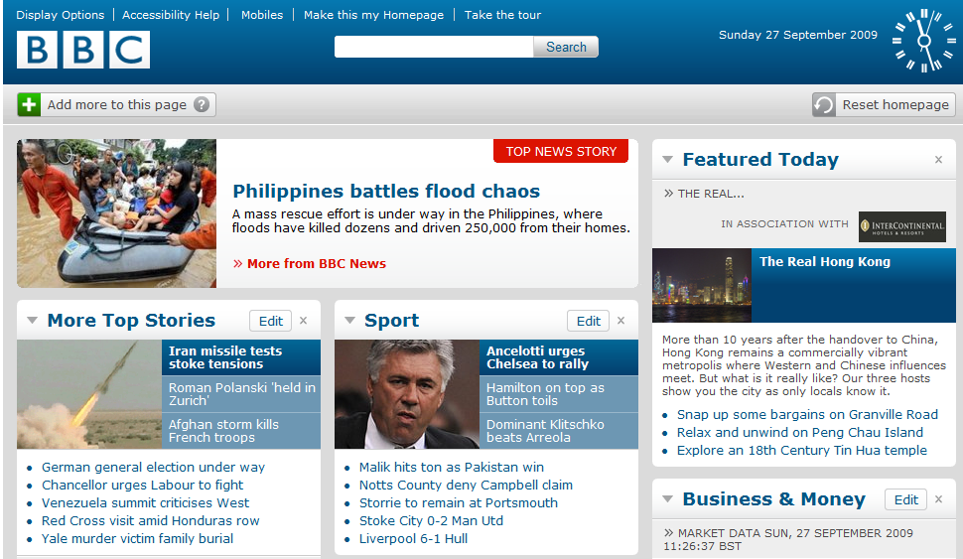

Slide 26
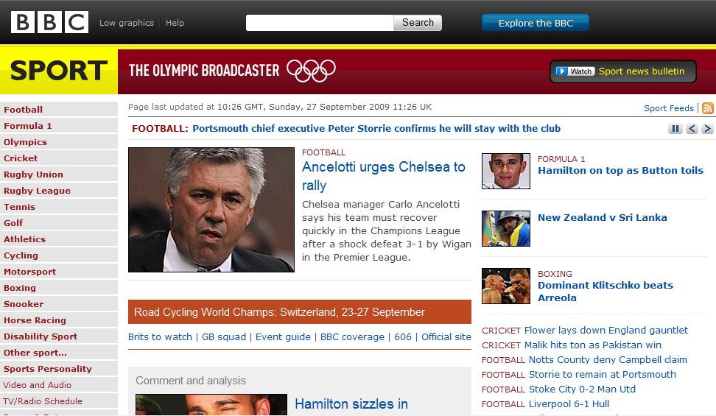

Slide 27
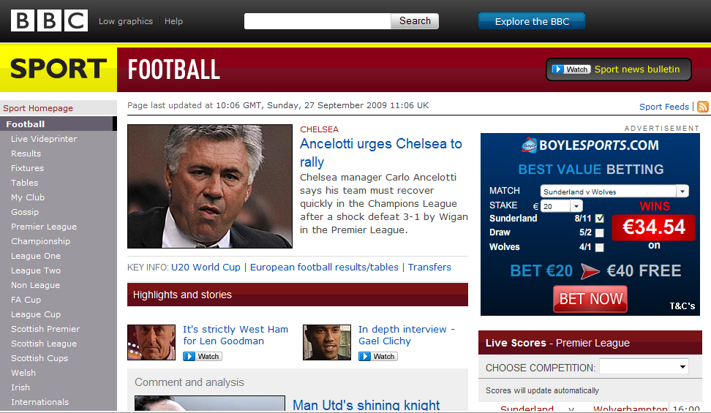

Slide 28
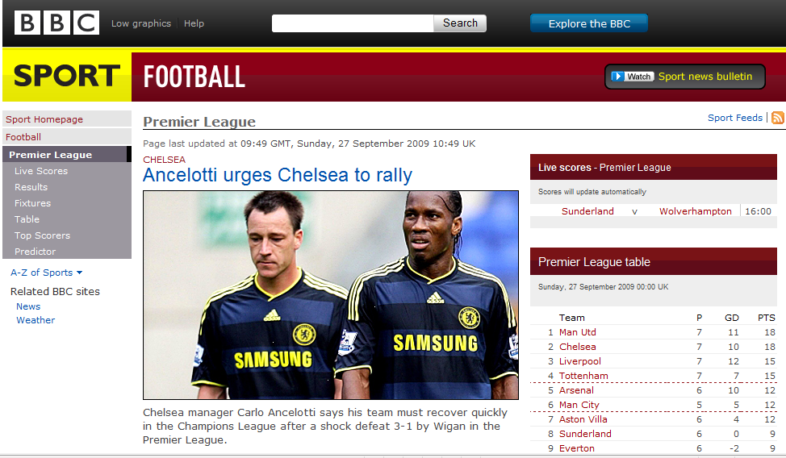

Slide 29
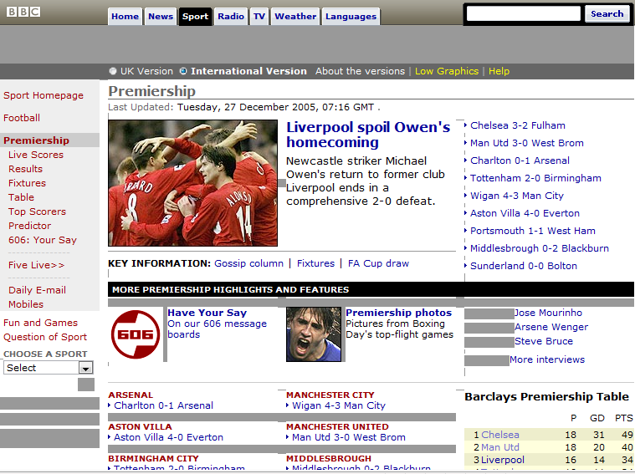

Slide 30


Slide 31


Slide 32
Sample Task
What are your company’s rules for maternity leave in your country?
32

Slide 33
Search
More search options Help
Intranet Home | Class B | Class C | About Me | About Company
Homepage
Expected
1st click

Slide 34
Search
More search options Help
Intranet Home | Class A | Class B | About Me | About Company
ABOUT ME
Training
Job Vacancies
Travel
Time and Payroll
Employee Benefits
Environment (Working, Local)
Career Development
About Me
Expected 2nd click

Slide 35
Search
More search options Help
Intranet Home | Class B | Class C | About Me | About Company
Homepage
Actual
1st click

Slide 36
Search
More search options Help
Intranet Home | Class A | Class B | About Me | About Company
ABOUT ME
Training
Job Vacancies
Travel
Time and Payroll
Employee Benefits
Environment (Working, Local)
Career Development
About Me
Actual 2nd click
for 6/15 users

Slide 37
Search
More search options Help
Intranet Home | Class A | Class B | About Me | About Company
ABOUT ME
Training
Job Vacancies
Travel
Time and Payroll
Employee Benefits
Environment (Working, Local)
Career Development
About Me
Only 1/15
clicked here

Slide 38
Search
More search options Help
Intranet Home | Class A | Class B | About Me | About Company
ABOUT ME
Training
Job Vacancies
Travel
Time, Leave and Payroll
Employee Benefits
Environment (Working, Local)
Career Development
About Me
13/15
clicked here

Slide 39
THE SUPER TASK
Notes:
39
Our next example: An International manufacturer of audio and video products for use at home, in the car and in business environments.
[NEXT SLIDE]

Slide 40
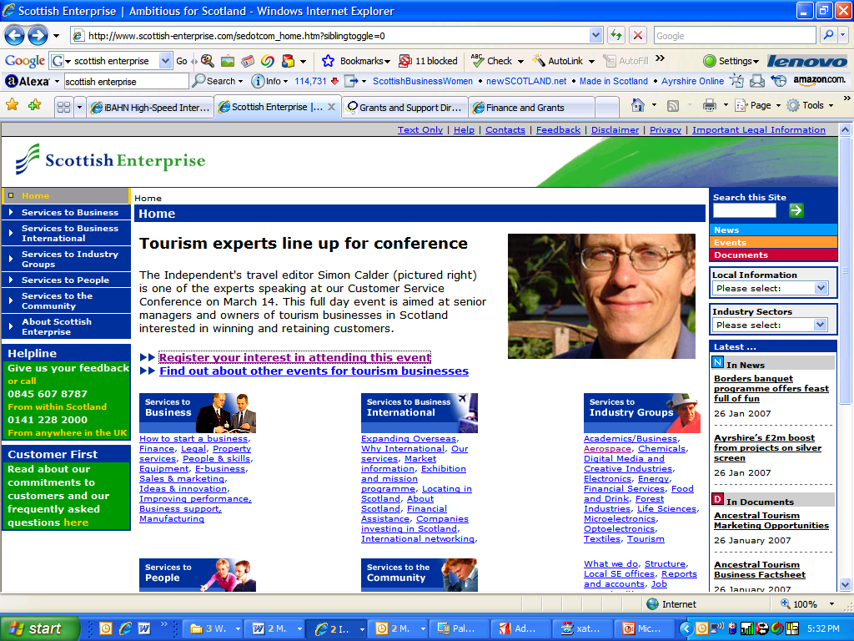
Writing for the web

Slide 41
Scottish Enterprise: Top Tasks
FUNDING

Slide 42
Bottom 20 Tasks

Slide 43
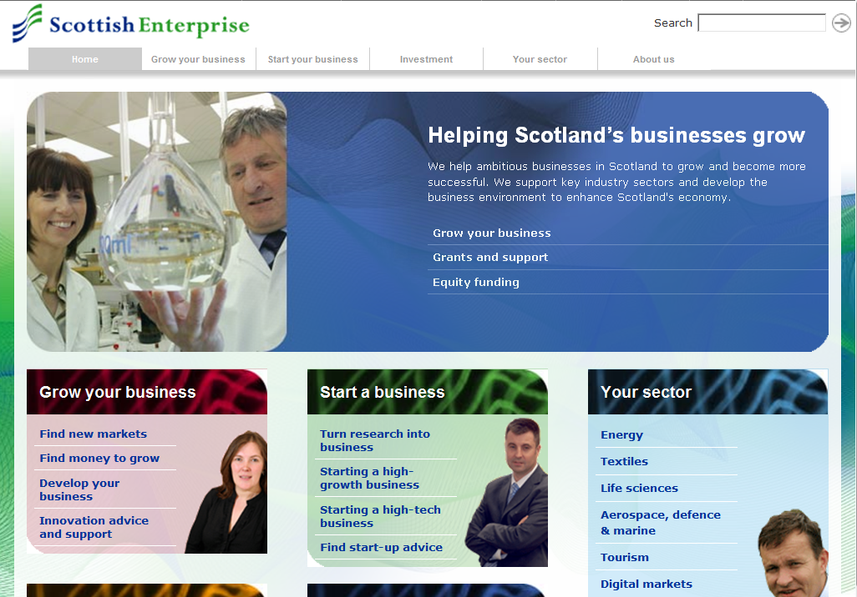

Slide 44
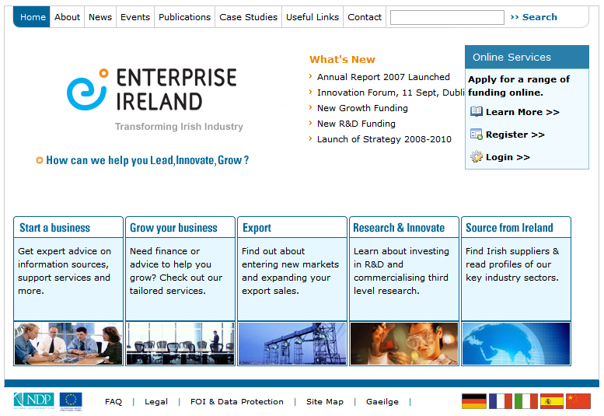
Notes:
44

Slide 45
Top 20 Tasks: Enterprise Ireland
FUNDING

Slide 46
Bottom 20 Tasks: Enterprise Ireland

Slide 47
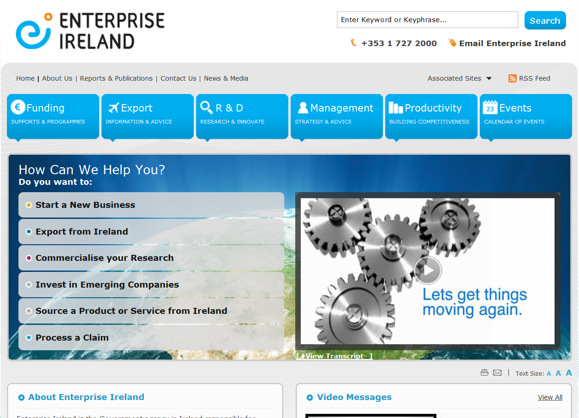

Slide 48
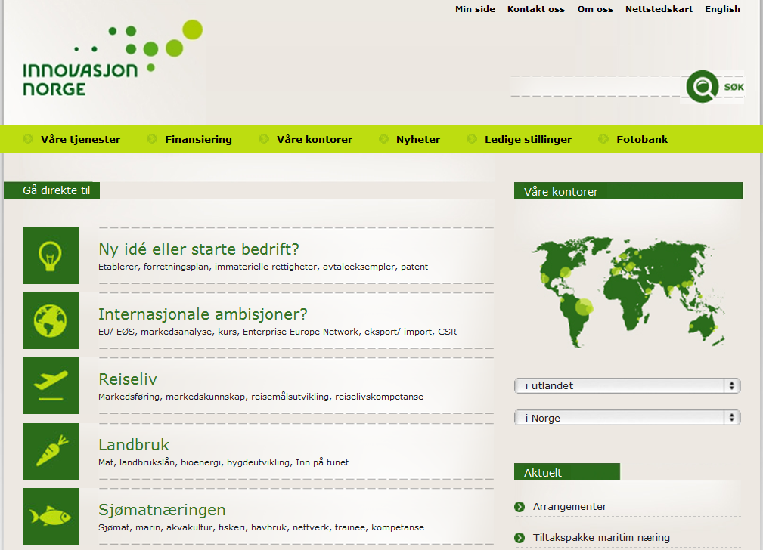

Slide 49
Top 20 Tasks: Innovation Norway
FUNDING

Slide 50
Bottom 20 Tasks: Innovation Norway

Slide 51
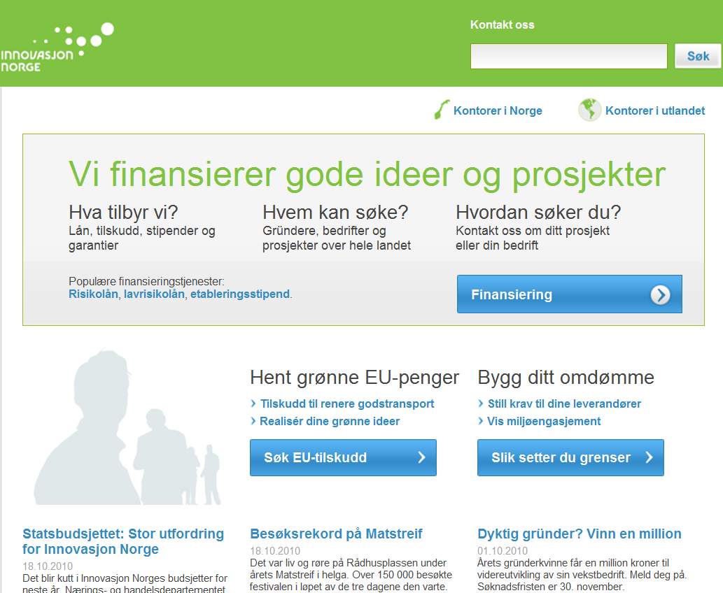
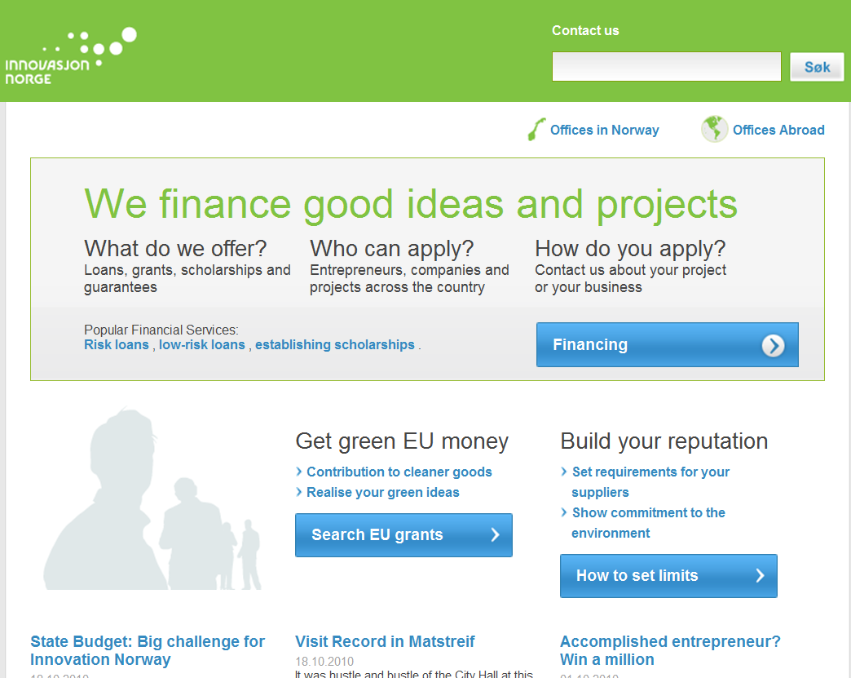

Slide 52


Slide 53
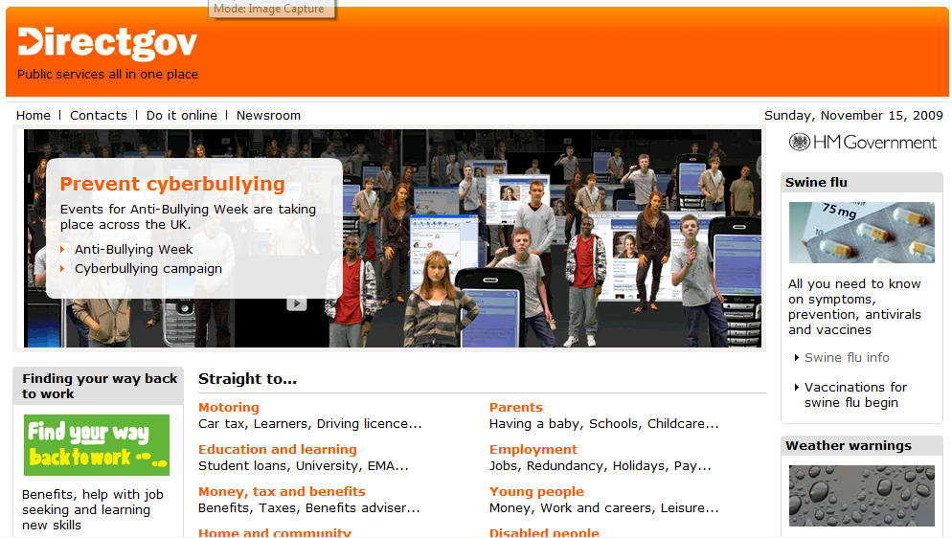

Slide 54
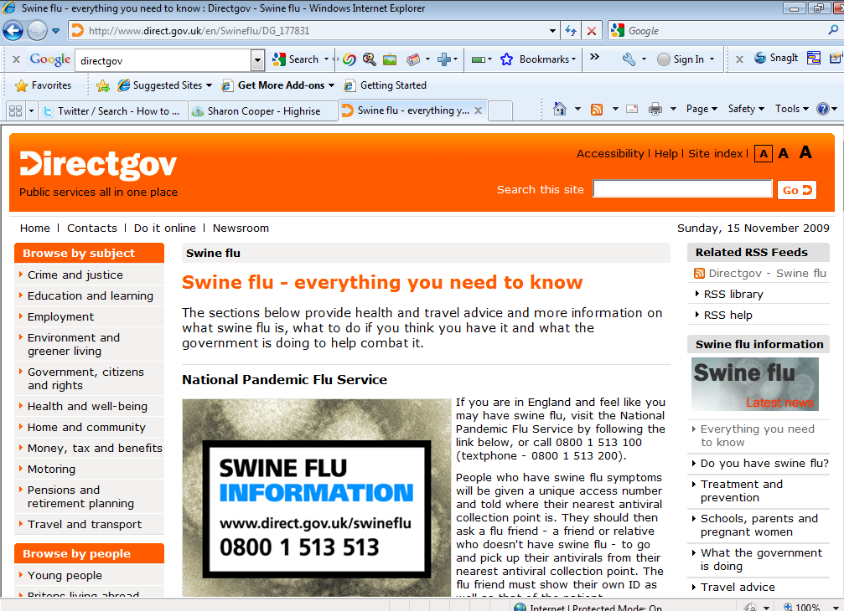

Slide 55
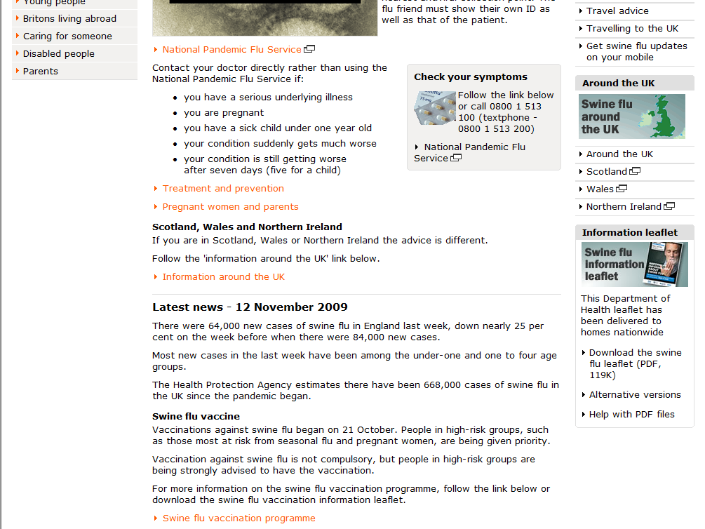

Slide 56
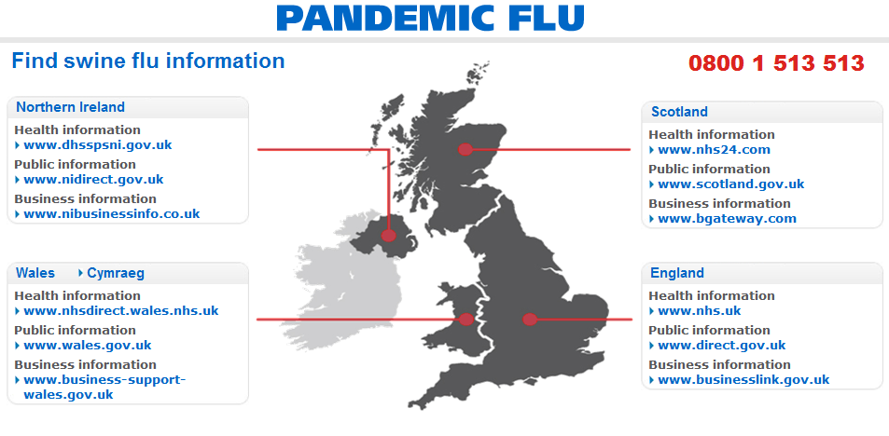

Slide 57
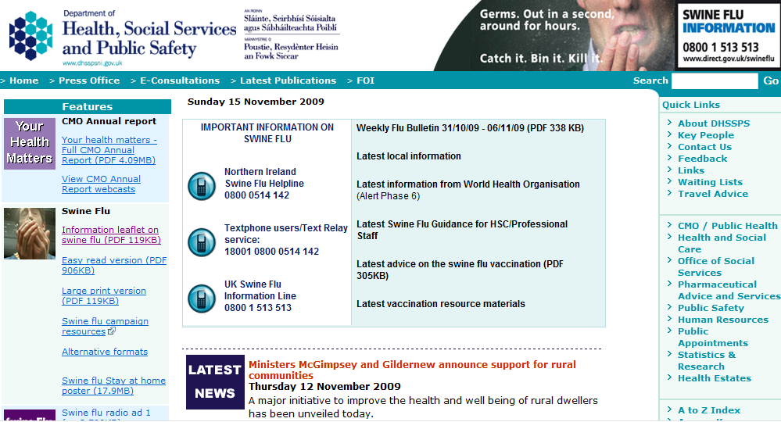

Slide 59
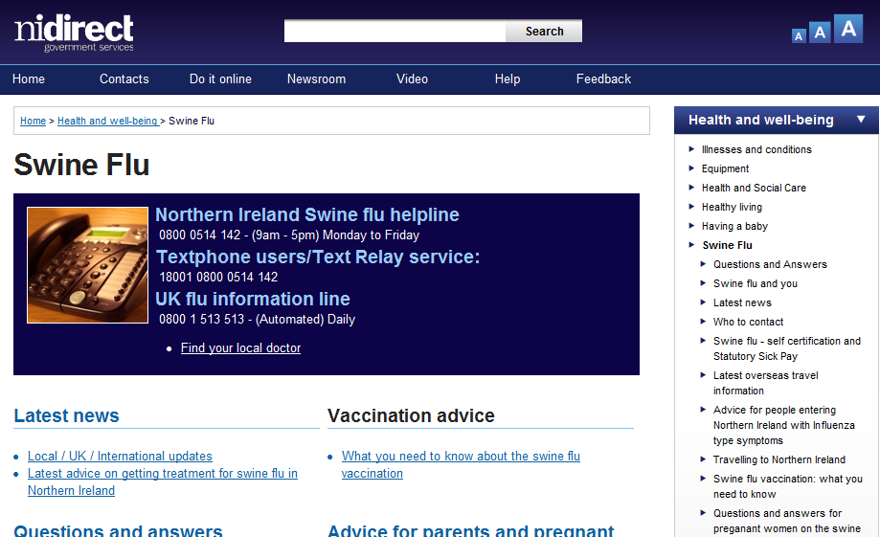

Slide 60
Questions and Answers
What is swine flu?
What is a pandemic?
How is swine flu different from seasonal flu or bird flu?
What can you do to protect yourself and others?
What is the government doing to prepare?

Slide 61
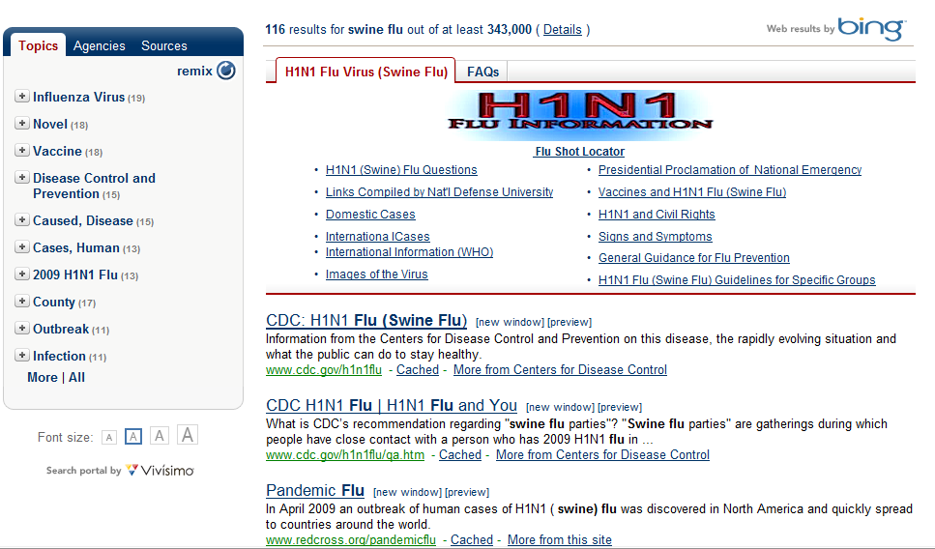

Slide 62
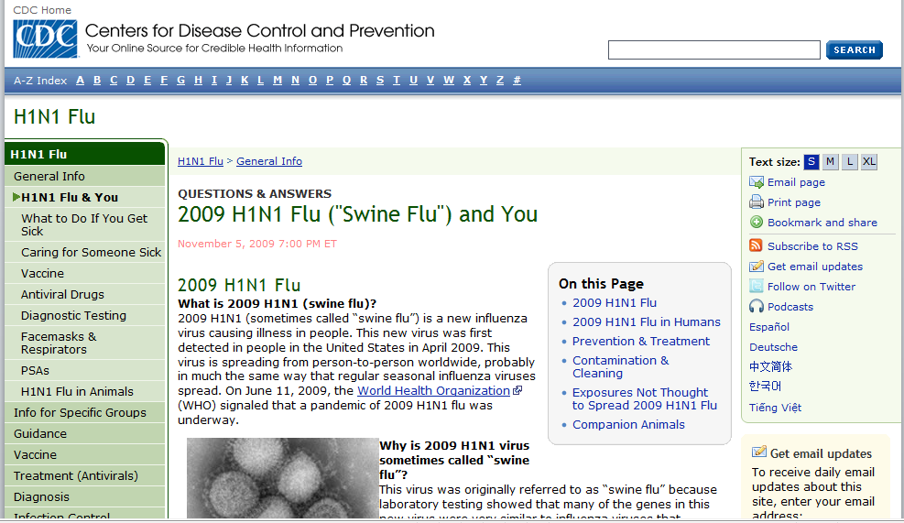

Slide 63
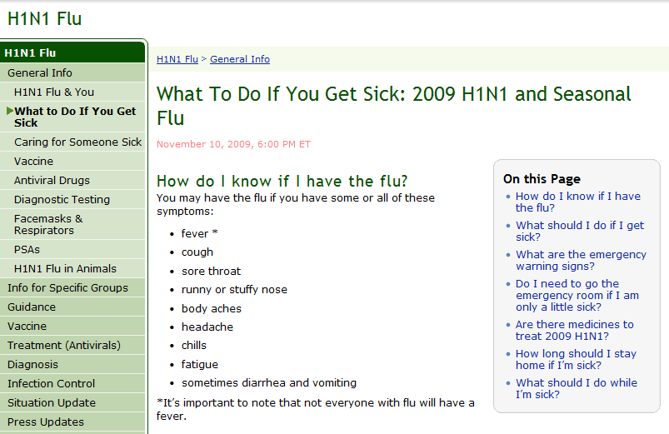

Slide 64
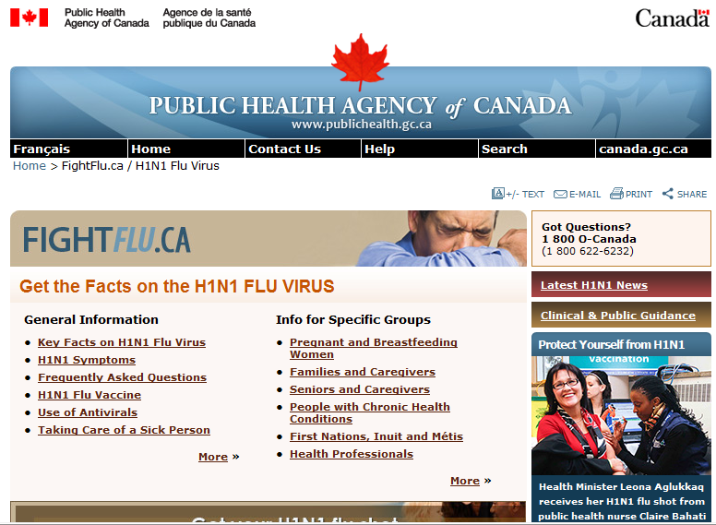

Slide 65
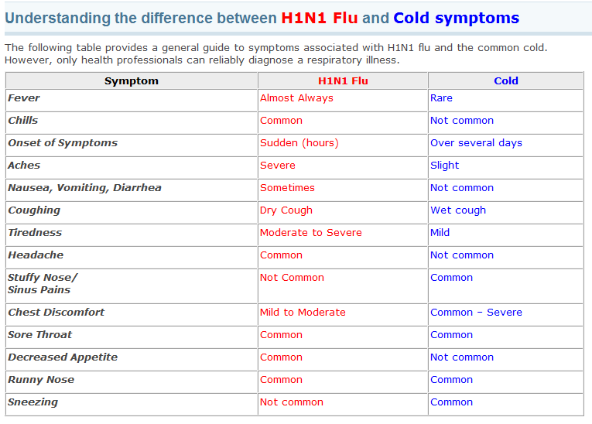

Slide 66


Slide 67
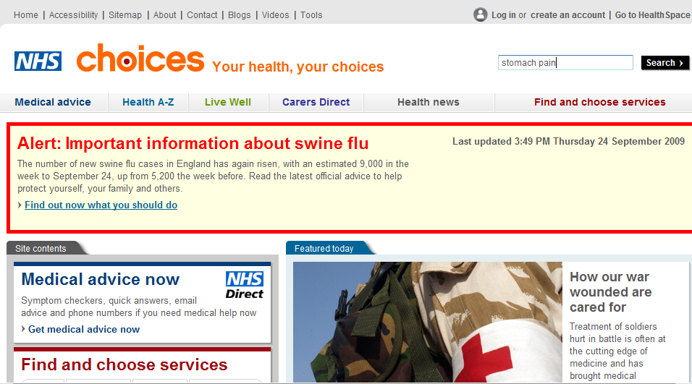

Slide 68
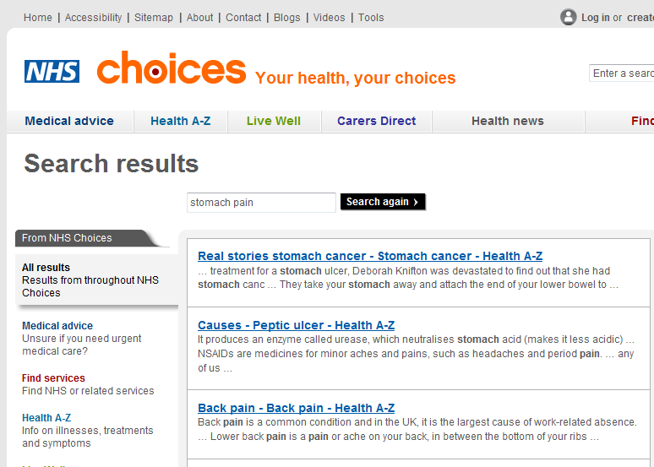
During treatment for a stomach ulcer, Deborah Knifton was devastated to find out that she had stomach cancer. At the age of 40, she had surgery to remove her stomach.

Slide 69
EXERCISE

Slide 70
Shortlist

Slide 71
Shortlist

Slide 72
Longlist

Slide 73
Sources for Longlist
Organization strategy
Stakeholder interviews
Examine existing website
Analyze top search terms
Most visited webpages
Competitor or peer websites
Relevant media
Customer feedback / research
Notes:
Organization strategy: Analyze corporate philosophy, vision and strategy statements. What does the organization want to achieve over the next five years, and specifically what does it want to achieve on the Web? It is very important that you link your website strategy to the overall strategy of the organization. This seems obvious but strangely many websites are disconnected from core organizational aims and objectives.
Stakeholder interviews: Talk to key people within the organization and find out what they think the purpose of the website is. What do they think the customer’s top tasks are? What do they think the top tasks should be?
Examine existing website: A good way to start is to copy level 1 and 2 of the website classification into the longlist. Another good source is the site index.
Analyze top search terms: Do this by:
Analyzing data from the website search engine. Try to get the top 100 search terms over a 12 month period.
Google Adwords: https://adwords.google.com/select/KeywordToolExternal. Enter important words and phrases so as to see how people are searching for them. For example, when we tested for “flu” we noticed that the following terms were particularly searched for: flu symptoms, swine flu symptoms.
Google Trends: http://www.google.com/trends. If you want to do deeper research and compare search word trends over several years, then Google Trends is the place to go.
Most visited webpages: What are the top 100 most visited pages on the website over the last year? (For a smaller website, the top 50 would be enough.)
Competitor or peer websites: A minimum of 4-6 should be analyzed for tasks, particularly at a homepage level.
Relevant media: Are there magazines, specialist industry websites, associations, etc.?
Customer feedback: What are the most common customer inquiries and complaints? Talk to support, help and sales staff to get this sort of data.
Customer research: Are there any surveys or other research that show what tasks customers come to the website to complete?
Customer interviews: For a large project, we would generally try to do 10-20 customer interviews. We don’t usually discover new tasks that we have not already discovered as a result of analyzing the sources

Slide 74
NO TOOLS / FORMATS
Calculators
Interactive Health Tutorials
Medical Podcasts
Personal Health Tools
Picture slideshows
Podcasts
Surgery Videos
Videos

Slide 75
NO GOALS
I'd like to be happier
I'd like to have more energy
I'd like to improve my family's health
I'd like to sleep better
Live well

Slide 76




NO BRANDS

Slide 77
NOT TOO HIGH
Facts and Figures
Conditions
Diseases
Find services
Frequently asked health questions
Injury Prevention
Medical conditions
Mind, Body, & Spirit

Slide 78
NOT TOO LOW
Emergency contraception
Nonprofit Agencies
Poems and stories about health
Cancer
Diabetes
Walk-in centres

Slide 79
NO DUPLICATES

Slide 80
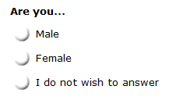
NO DEMOGRAPHICS

Slide 81
Task Voting Question
Please look at the following list and choose ONLY the top FIVE Tasks that are of most relevance to you.
Give a score of 5 to the MOST IMPORTANT to you, 4 to the next most important, then 3, 2, and 1.
Please give ONLY one score of 5, one 4, one 3, one 2, and one 1. Leave the rest blank.
Please trust your first instincts and spend no more than 5 minutes on this exercise.

Slide 82
Task Voting Question
Please look at the following list and choose the top FIVE most important things to you in deciding to buy a new car.
When using a health website what 5 factors are most important to you? Please look at the following list and choose ONLY the top FIVE Topics that are of most relevance to you.
Please look at the following list and choose ONLY the top FIVE Topics that are of most relevance to your Business on the Enterprise Ireland website.
Below is a list of typical IT-related challenges that organizations face. Choose the top FIVE challenges you face for which you would consider looking for support from an external company.
Select the FIVE words or phrases from the following list that reflect the most important things to you in relation to a satellite navigation system.

Slide 83
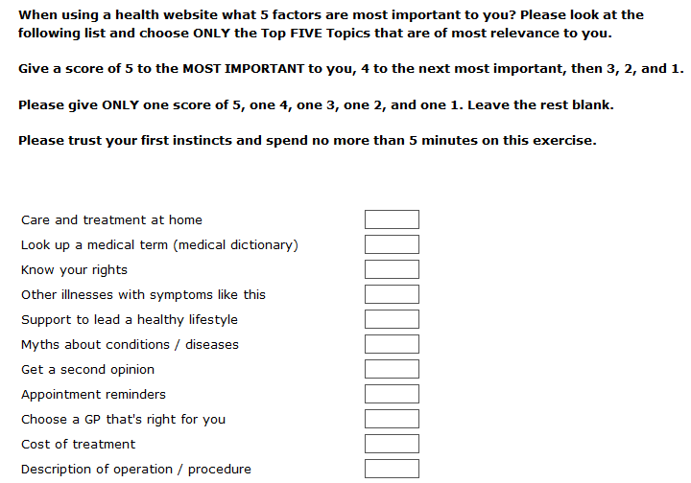

Slide 84
Task Measurement
... Because You Can’t Manage What You Can’t Measure
Manage tasks:
Not content
Not technology

Slide 85


Slide 86
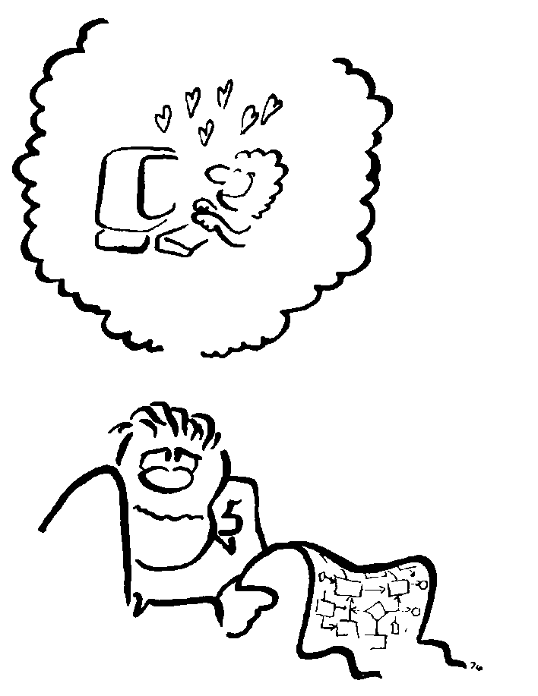
Step 1: Determine Tasks
Determine 6-12 frequently used tasks.

Slide 87
Task Question Checklist
One unique answer
Does not contain hidden clues
Emotionally neutral
Not confidential

Slide 88
Task Question Checklist
Clearly different from other tasks
Independent from other tasks
Immediately doable on the website
Short – 30 words or less

Slide 89

Task 1 | 1 Japan What are the OECD’s latest recommendations regarding Japan’s health-care system?
Task 2 | 2 Vietnam In 2008, was Vietnam on the list of countries that received official development assistance?
Task 3 | 3 Heart Did more males per capita die of heart attacks in Canada than in France in 2004?
Task 4 | 4 Teacher What is the latest average starting salary, in US Dollars, of a primary school teacher across OECD countries?
Task 5 | 5 Employ What is the title of Box 1.2 on page 73 of OECD Employment Outlook 2009?

Slide 90

Step 2: Recruit Participants
Recruit 15-18 representative people

Slide 91
Remote Measurement Sessions
Record session
“We are not measuring you”
Measure time for each task.
Observe problems and successes.
No “think aloud”, no discussions

Slide 92
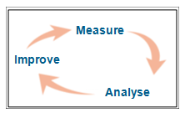

Slide 93
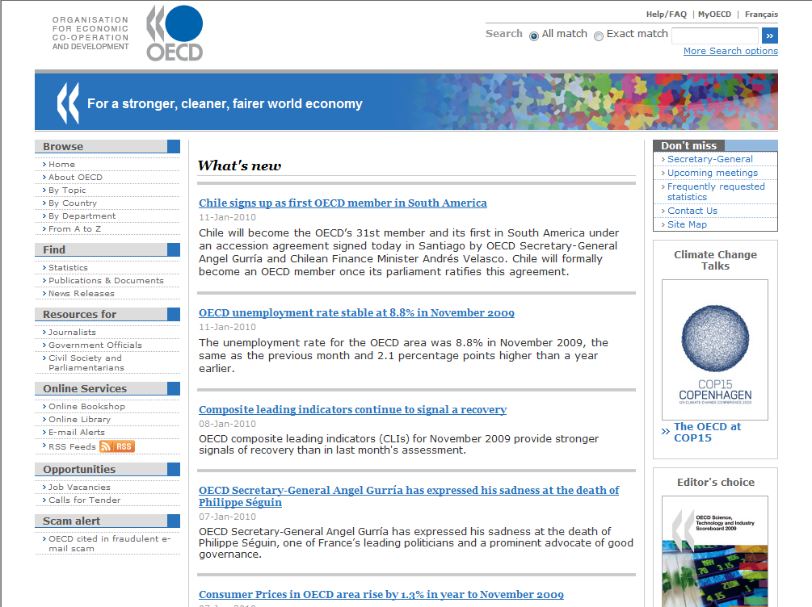

Slide 94
Tasks Pie Chart

Slide 95
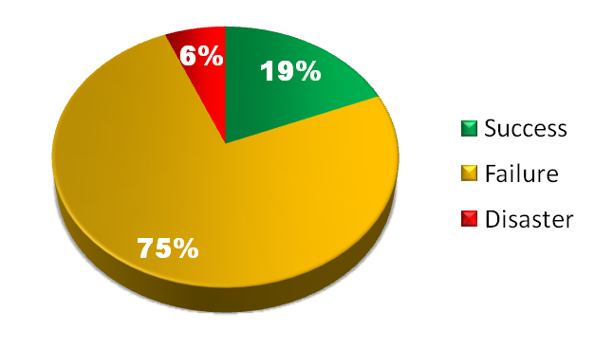
Task 5 – Box 1.2 Employment
What is the title of Box 1.2 on page 73 of OECD Employment Outlook 2009?
Task Performance
Task Performance Indicator (TPI) 100 Max 9
Median time on task (sec) = | 215
Optimal time on task (sec) = | 81

Slide 96
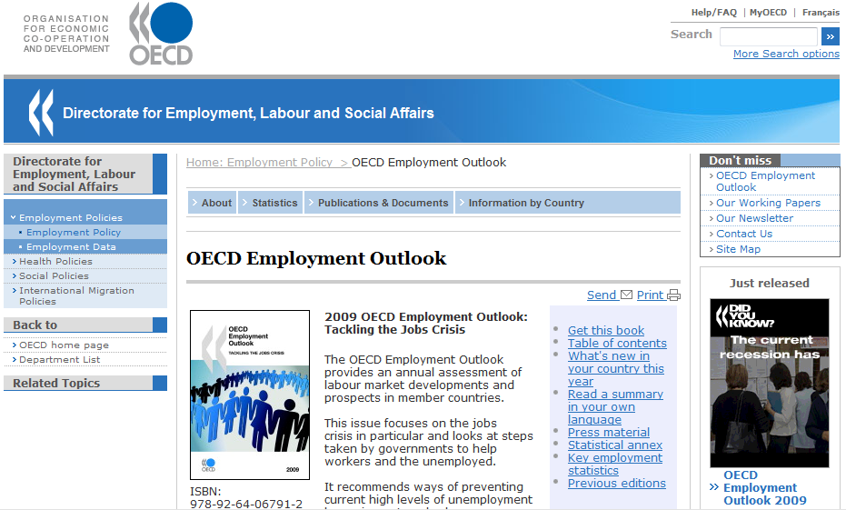

Slide 97
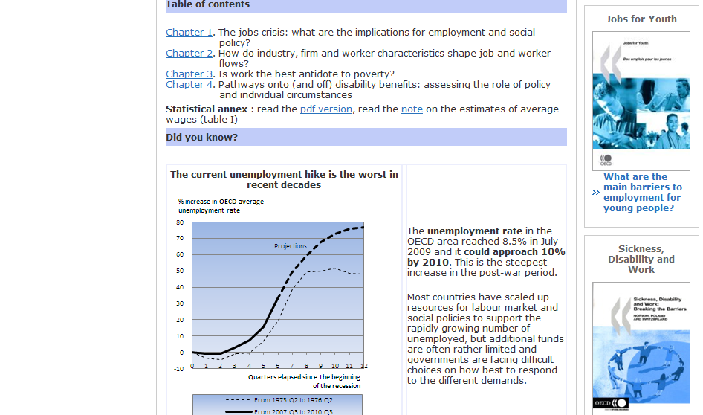

Slide 98
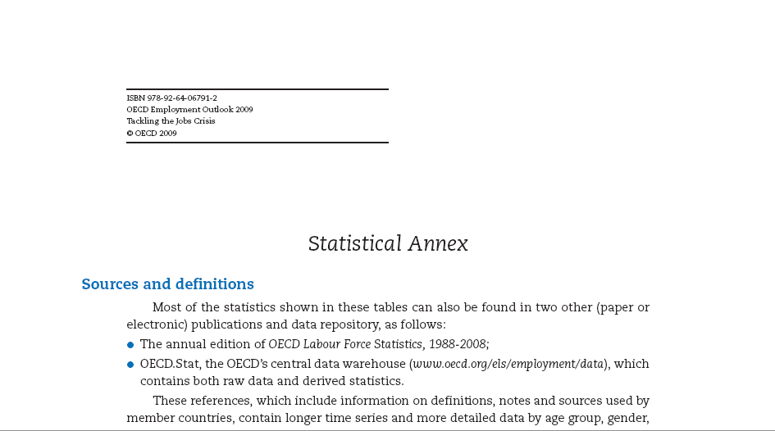

Slide 100

Subscribers and readers at subscribing institutions
Government officials with accounts
Accredited journalists
Non-subscribers: browse online version for free
Non-subscribers: purchase a copy

Slide 101


Slide 102


Slide 103


Slide 104

Task 8 – Tax haven removal
When were Andorra, Liechtenstein and Monaco removed from the OECD’s list of tax havens?
Task Performance
Task Performance Indicator (TPI) 100 Max 78
Median time on task (sec) = | 125
Optimal time on task (sec) = | 84

Slide 105


Tax
Heavens

Slide 106


Slide 107




Slide 108


Slide 109


Slide 110


Slide 111


Slide 112


Slide 113


Slide 114

20 million clicks
650,000 searchers
Source: http://www.techcrunch.com/2006/08/06/aol-proudly-releases-massive-amounts-of-user-search-data/
Notes:
Private Data
483 Comments
by Michael Arrington on August 6, 2006
Yet Another Update: AOL: “This was a screw up”
Further Update: Sometime after 7 pm the download link went down as well, but there is at least one mirror site. AOL is in damage control mode – the fact that they took the data down shows that someone there had the sense to realize how destructive this was, but it is also an admission of wrongdoing of sorts. Either way, the data is now out there for anyone that wants to use (or abuse) it.
Update: Sometime around 7 pm PST on Sunday, the AOL site referred to below was taken down. The direct link to the data is still live. A cached copy of the page is here.
AOL must have missed the uproar over the DOJ’s demand for “anonymized” search data last year that caused all sorts of pain for Microsoft and Google. That’s the only way to explain their release of data that includes 20 million web queries from 650,000 AOL users.
The data includes all searches from those users for a three month period this year, as well as whether they clicked on a result, what that result was and where it appeared on the result page. It’s a 439 MB compressed download, expanded to just over 2 gigs. The data is available here (this link is directly to the file) and the output is in ten text files, tab delineated.
The utter stupidity of this is staggering. AOL has released very private data about its users without their permission. While the AOL username has been changed to a random ID number, the abilitiy to analyze all searches by a single user will often lead people to easily determine who the user is, and what they are up to. The data includes personal names, addresses, social security numbers and everything else someone might type into a search box.
The most serious problem is the fact that many people often search on their own name, or those of their friends and family, to see what information is available about them on the net. Combine these ego searches with porn queries and you have a serious embarrassment. Combine them with “buy ecstasy” and you have evidence of a crime. Combine it with an address, social security number, etc., and you have an identity theft waiting to happen. The possibilities are endless.

Slide 115

First 2 Search Results
Source: Accurately Interpreting Clickthrough Data as Implicit
Feedback (2005) http://www.cs.cornell.edu/People/tj/publications/joachims_etal_05a.pdf
Notes:
Jakob Nielsen's Alertbox, September 26, 2005:
The Power of Defaults
Summary:
Search engine users click the results listings' top entry much more often than can be explained by relevancy ratings. Once again, people tend to stick to the defaults. How gullible are Web users? Sadly, the answer seems to be "very."
Professor Thorsten Joachims and colleagues at Cornell University conducted a study of search engines. Among other things, their study examined the links users followed on the SERP (search engine results page). They found that 42% of users clicked the top search hit, and 8% of users clicked the second hit. So far, no news. Many previous studies, including my own, have shown that the top few entries in search listings get the preponderance of clicks and that the number one hit gets vastly more clicks than anything else.
What is interesting is the researchers’ second test, wherein they secretly fed the search results through a script before displaying them to users. This script swapped the order of the top two search hits. In other words, what was originally the number two entry in the search engine's prioritization ended up on top, and the top entry was relegated to second place.
In this swapped condition, users still clicked on the top entry 34% of the time and on the second hit 12% of the time.

Slide 116
1,500 intranet searches
5% of searches = 35% of volume
Long Neck

Slide 117
Search Performance Indicator
Top 100-500 search terms
“Correct page” for each term
Search with each term
Score
Rank | Score
1 | 100
2 | 36
3 | 26
4 | 16
5 | 14
6 | 12
7 | 9
8 | 9
9 | 7
10 | 8
11 + | 0

Slide 118
Search Term | Search Volume
classical studies | 81
classical studies department | 12
classical latin | 8
classical greek | 7
classics courses | 7
classics department | 6
classical studies diploma | 5
classical studies dept | 3
classical studies website | 3
classical studies webpage | 2
classical greece | 1
classical texts | 1

Slide 119



Slide 120





Slide 121

“Most people just look at the first couple of words.”
Copyright Eyetrack III 2004

Slide 122
Changing our intranet
Make employees more productive – Release time for other productive work
Security level
NN/MMYY

Slide 123
Tasks Votes % Cum % Cum
vote words
Find Tetra Pak people 1184 10 10 1
Product portfolio 448 4 13 2
Vacancies at Tetra Pak 444 4 17 3
Technical documentation 429 3 20 4
Filling machines 429 3 24 5
Packaging Material 387 3 27 6
World Class Manufacturing (WCM) 326 3 30 7
Marketing & sales tools 317 3 32 8
Product Information Viewer (PIV) 316 3 35 9
Training 310 3 37 10
Procedures, policies & guidelines 292 2 40 11
Processing equipment 285 2 42 12
Technical manuals 265 2 44 13
Time reporting 247 2 46 14
Sales manual 218 2 48 15
Technical maintenance & support 214 2 50 16
Notes:
How did we derive the tasks?
We started with an extensive focus interview to genrerate the task carewords. We sent out surveys to 12000 employees to identify the top 100 tasks.
3000 employees responded. We compiled a list of top 100 most frequently performed tasks and we tested these tasks throughout the organisation.
We can see from this list that the top 5 tasks constitute almost 25% of the votes.

Slide 124
Long Neck delivers quick wins
Long Neck
Notes:
A relative small set of tasks got most votes. This is what we called the LONG NECK. Improving them will dramatically improve the intranet.

Slide 125

Measurement Overview

Slide 126


NAVIGATION
SEARCH
CONTENT QUALITY
Internal
E-communication/
1108
Notes:
In the first phase of the Task Based Intranet project, we put focus on fixing the basics. Fix The Basics focus on 3 areas: Navigation, Content Quality and Search.

Slide 127


NAVIGATION
Security level
NN/MMYY
Notes:
First of all I want to thank Nancy and Gabriel for inviting us here today.
My name is Karolina Bengtsson and I was offifically appointed the Task Driver for Search Sept.1st. – but I have been looking into this area since the beginning of this year. I have been working with the Intranet for 5 years.

Slide 128



Top level navigation
60 %
70 %
90 %

Slide 129
SEARCH
Security level
NN/MMYY
Notes:
First of all I want to thank Nancy and Gabriel for inviting us here today.
My name is Karolina Bengtsson and I was offifically appointed the Task Driver for Search Sept.1st. – but I have been looking into this area since the beginning of this year. I have been working with the Intranet for 5 years.

Slide 130
Search efficiency
Baseline vs today
Success 28%
Success 57%
Failure
72%
Failure
43%
Based on measurements from top 100 search terms
Notes:
The situation for search is bad – really bad.
When we started to measure this spring – only 28% of the seraches were sucessful – this is all based on serach statistics that we have.
Today – we have been able to improve these numbers – and now the success rate is on 57%.
How did we do this?

Slide 131
CONTENT QUALITY
Security level
NN/MMYY
Notes:
First of all I want to thank Nancy and Gabriel for inviting us here today.
My name is Karolina Bengtsson and I was offifically appointed the Task Driver for Search Sept.1st. – but I have been looking into this area since the beginning of this year. I have been working with the Intranet for 5 years.

Slide 132


Does web content matter?
It’s about…..
Publisher 10 min
10
Visitor 60 min
Visitor 60 min
Visitor 60 min
Visitor 60 min
300
Visitor 60 min
Notes:
A simple example to illustrate why web content matters.
Its about optimising the time spent for the visitors when they use the Intranet. Good content quality is the foundation of a trustworthy Intranet.
If the publisher spends 10 minutes in publishing, ( meaning that she is not putting efforts in controlling the quality of content published), visitors will have to spend 60 minutes each to look for the content.

Slide 133
Does web content matter?
It’s about…..
Publisher 60 min
60
Visitor 10 min
Visitor 10 min
Visitor 10 min
Visitor 10 min
50
Visitor 10 min
Notes:
However, if there is good quality content, the results will be different. Each visitor may now spend only 10 minutes each for the content. That is a saving of 250 minutes!
This will translate to productivity for the organisation because the employees can spend the time to do more productive work.

Slide 134


The Story of a Web Site
Once upon a time, there was a Web site…

Slide 135

…with a simple vision statement:
“Give your customers what they want”
“Help them find what they need”

Slide 136


The vision quickly becomes…
Publish
lots of cool content
to the site

Slide 137


And, the authors start publishing lots of good pages…

Slide 138

…and the site manager says, “Page views are going up, but we can do better!”

Slide 139

And the authors focus on creating more, better, faster…

Slide 140


But the analytics team walks in, and interrupts, “Wait a second here…”
Satisfaction is not moving up!
???

Slide 141
It turns out the customer isn’t happy with the growing site…
Not what I want!
Can’t find it!
Don’t like it!

Slide 142

So, the team decides to fix things…
Content issues? Revise it.
If at first you don’t succeed, try, and try again!

Slide 143



Search not working?
Add keywords. Lots of them. To every page.

Slide 144

Navigation not working?
Redesign the site. Add links. Put them on the home page.
I think this is what you really need.
Get this. Now!
You said you want this. Here you go.

Slide 145
But, things don’t get much better.
Success indicators still stay flat.

Slide 146
??
??
??

Slide 147


Slide 148
“I’m sure some users still use it!”
Many, many more users seem to be hating it!

Slide 149

“Taking things away isn’t the right thing to do. We should fix them.”
Weed NOW. Publish something good as soon as possible.
The publish queue…

Slide 150
“OK, they are not useful, but certainly there is no harm in just leaving them there?”
There is. It prevents users from finding our good pages.

Slide 151
“How do we remove pages???
“How do we reduce page views???

Slide 152


#1 Remove Pages from Site
Remove Conditional Formatting
Notes:
Our original team agreement was to remove, or expire pages as a FIRST resort, so we looked at the traffic patterns and customer feedback to figure out what was happening.
In this example:
Many customer comments for the “Removing conditional formatting” article indicated that they weren’t really looking just for removing conditional formatting, but really needed to figure out to use the feature—how to apply it, how to remove it (yes), and how to change conditional formatting once it was applied—most likely this is what led them to search for how to remove it.
Sometimes customers look for one thing, but really need something else, or something more.

Slide 153

“Remove conditional formatting”
“Format text in a variety of ways based on conditions”
Remove Conditional Formatting
Notes:
Talking points:
The “Removing conditional formatting” article was attracting a lot of attention from customers who needed more than just the removal procedure—they really needed to understand how to get the conditional formatting feature to work for them.
The “Format text in a variety of ways based on conditions” article had that comprehensive help they needed—it also provided the context for the removal procedure.

Slide 154













#2 Remove Links to Page
Notes:
Another strategy we used was removing links to pages—this includes See Also links and inline links from one page to another. For example…

Slide 155

Page views fell by over 77%
Dissatisfaction fell by over 15%

Slide 156


#3 Hide Pages from Search
Sum / add a number
Notes:
The Excel Function Reference was notorious for generating dissatisfaction—we couldn’t remove these pages because they are mapped to the UI. We started looking at customer feedback and realized that the wrong customers were finding these topics. For example…

Slide 157



Notes:
Non-search entries include the help button in the application, links between topics within the function reference, and links from specific topics—these specific topics provide the context necessary for customers to successfully use the reference content.

Slide 158


Slide 159


Slide 160
FREE
A free weekly email newsletter on web content. To subscribe, please send an email to:
gerry@gerrymcgovern.com

Slide 161

161

